Slide 1
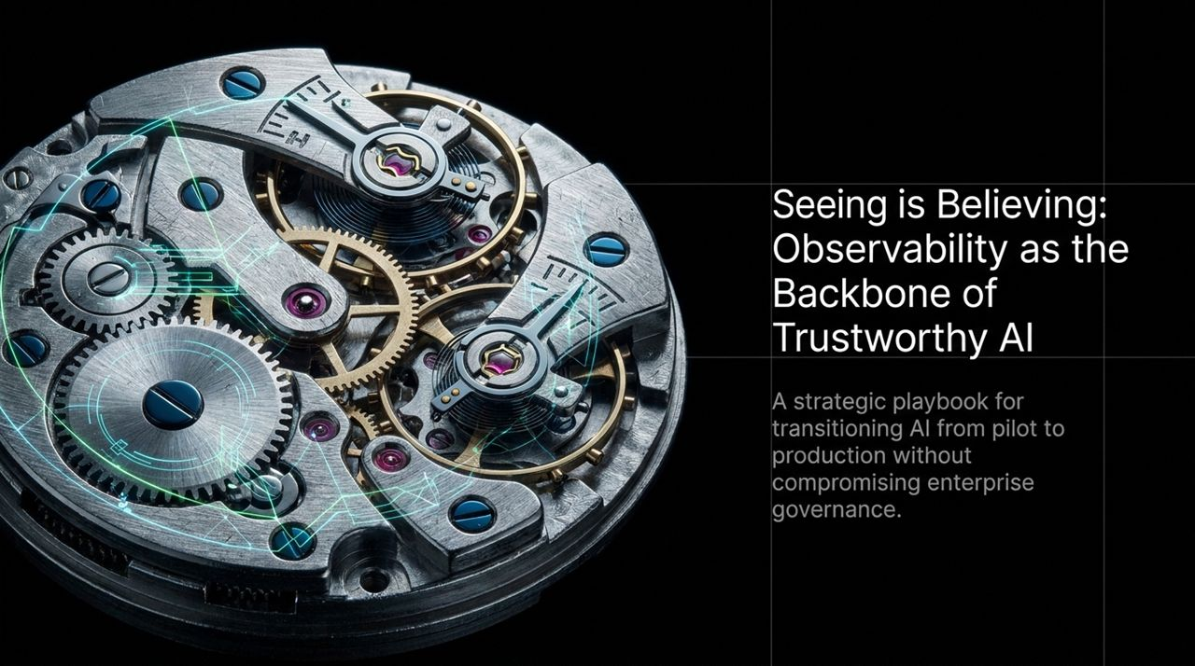
Notes:
Good morning, good afternoon, and good evening, everyone. Welcome to our session on Trustworthy AI Observability.
Over the past two years, enterprise AI has moved past initial experimentation. Organizations have deployed Large Language Models and intelligent agents into core workflows—from HR ticketing to financial processing and supply chain management.
However, as AI touches mission-critical transactions, a fundamental issue emerges: How do we trust an autonomous system when we cannot see how it arrives at its decisions?
Today, we present a strategic playbook for transitioning AI from isolated pilots to scalable production environments without compromising governance, security, or accuracy.
Our central thesis throughout this deck is simple: Trustworthy AI starts with visibility. You cannot trust what you cannot see.
Seeing Is Believing: AI Observability & Trustworthy AI with SAP & Dynatrace | Webinar Replay
https://www.youtube.com/watch?v=LglWwQRNhoI

Slide 2
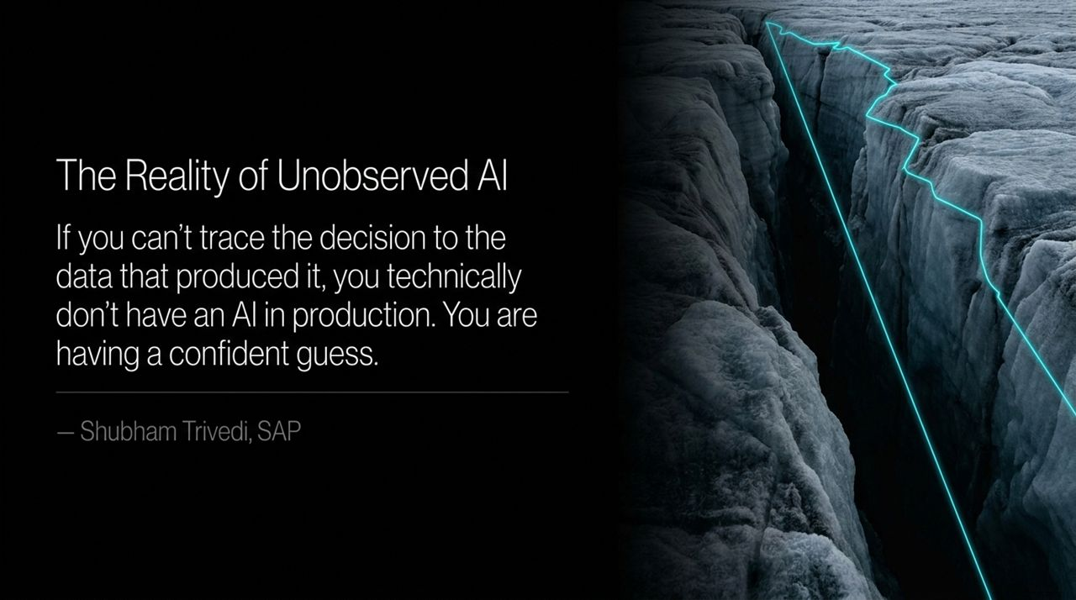
Notes:
To begin, let’s reflect on a powerful quote from Shubham Trivedi at SAP: 'If you can't trace the decision to the data that produced it, you technically don't have an AI in production. You are having a confident guess.' [41:01]
In traditional software, execution is deterministic—a function takes an input and produces an expected output based on fixed code.
In Generative AI and agentic systems, outputs are probabilistic. A model can present inaccurate or completely fabricated information with high linguistic confidence.
If your organization relies on AI to approve financial transactions, adjust procurement orders, or draft policy responses, unobserved AI represents an unquantified liability.
Without a clear link connecting the final answer back to the exact system prompt, vector database lookup, and raw input data, your team is operating on hope rather than governance.

Slide 3
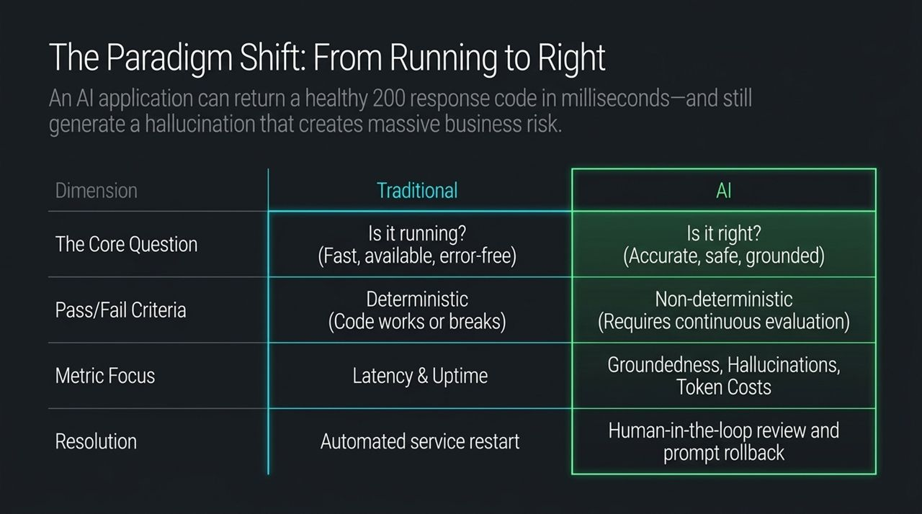
Notes:
For decades, IT operations evaluated system health using a straightforward question: Is it running?
If your application returns an HTTP 200 response code, responds in 150 milliseconds, and maintains 99.99% uptime, standard APM tools flag the system as 'green'.
In the AI era, this metric framework breaks down. An LLM endpoint can return an HTTP 200 response code in milliseconds, yet deliver a severe hallucination that breaches compliance or misinforms a customer.
This introduces a much harder fundamental question: Is it right?
Let's review the key differences outlined on this slide:
Core Question: Shift from system availability (Is it running?) to output validity (Is it right?).
Pass/Fail Criteria: Shift from deterministic pass/fail code paths to continuous non-deterministic evaluation.
Metric Focus: Expand beyond latency and uptime to measure groundedness, hallucination rates, and token cost-per-task.
Resolution: Upgrade from automated service restarts to human-in-the-loop reviews, prompt rollbacks, and dynamic routing.

Slide 4
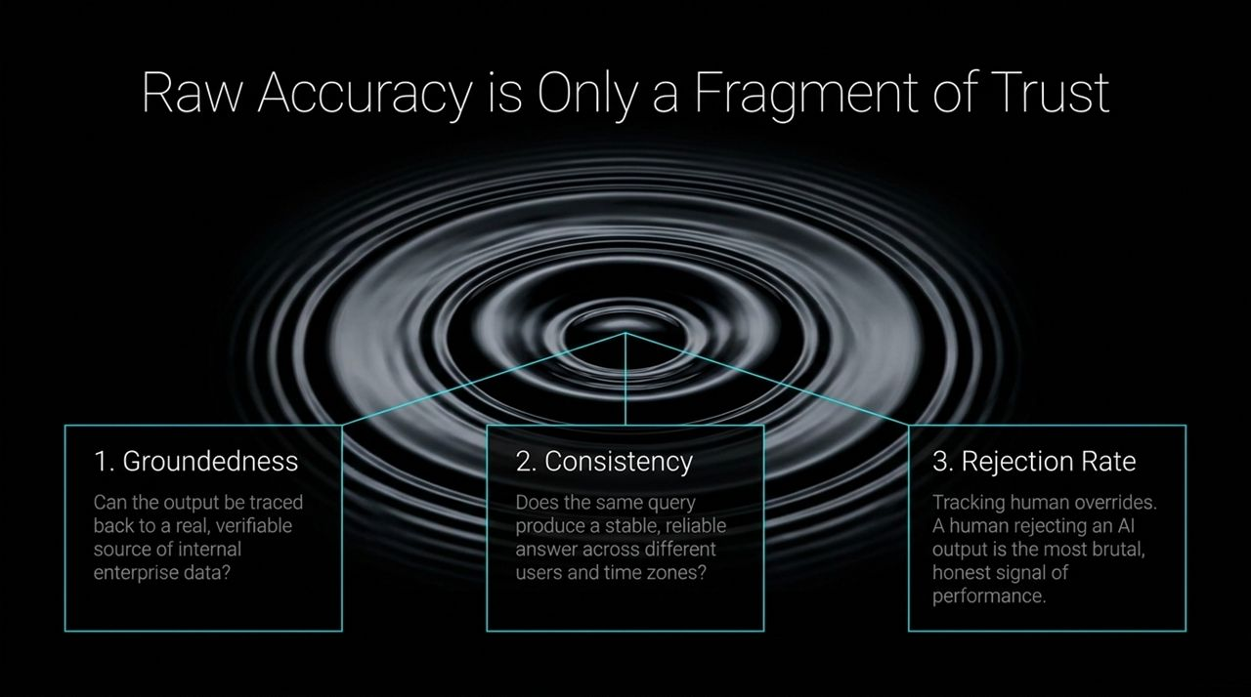
Notes:
When evaluation teams evaluate AI models, they often over-index on raw accuracy or standardized benchmark scores.
However, high test accuracy in a lab environment rarely guarantees trust in enterprise production. As discussed during our panel, true operational trust requires evaluating three additional critical signals:
1. Groundedness: Can the output be traced directly back to a verifiable, authoritative internal dataset? If an HR assistant answers a leave policy question, did it retrieve that answer directly from the active enterprise policy document? [
2. Consistency: Does the model deliver a stable, reliable response across varying time zones, user personas, or repeated queries?
3. Rejection Rate: Tracking human overrides. As Shubham noted, when a human employee or end-user actively rejects or overrides an AI suggestion, that is the most honest and brutal signal of real-world model failure.

Slide 5
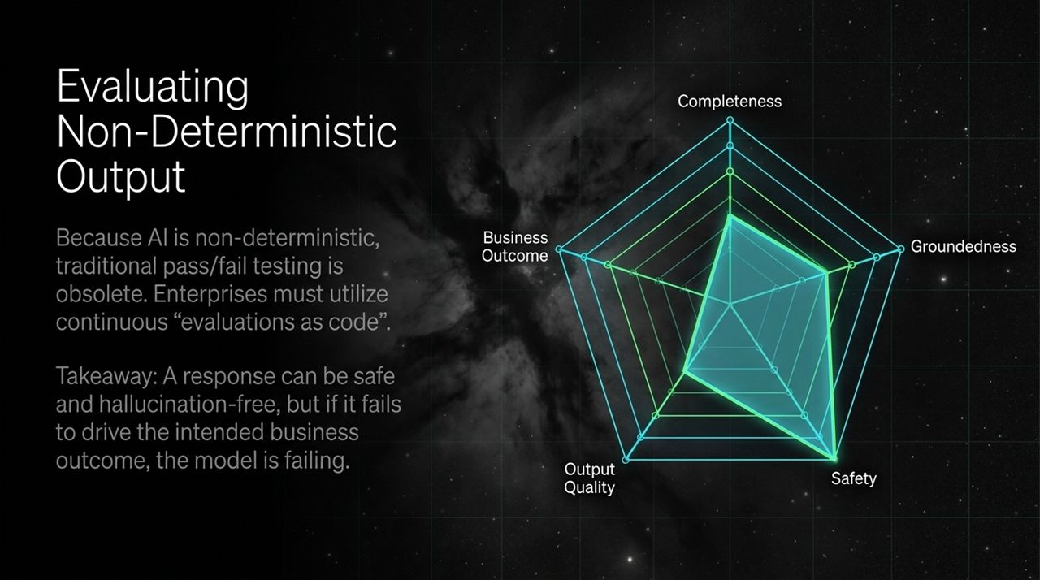
Notes:
Because Generative AI outputs are non-deterministic, static, one-time unit tests are obsolete.
To ensure output safety, enterprise engineering teams must adopt continuous 'Evaluations as Code'.
This spider diagram illustrates a balanced 5-point evaluation radar for production AI:
Completeness: Did the response address every component of the user's prompt?
Groundedness: Is every claim supported by retrieved enterprise data?
Safety: Did the output adhere to corporate safety, privacy, and PII guardrails?
Output Quality: Is the response clear, coherent, and appropriately formatted?
Business Outcome: Did the interaction successfully resolve the user's intent?
Takeaway: A response can be safe, complete, and hallucination-free—but if it fails to drive the intended business outcome, the AI model is failing.

Slide 6
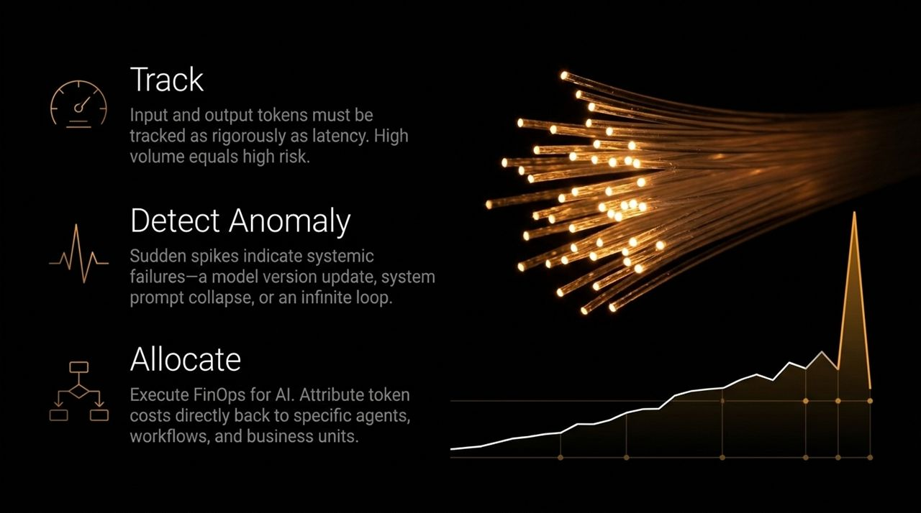
Notes:
As organizations scale AI beyond initial pilots, financial controls become a mandatory pillar of observability.
During early proof-of-concept phases, token consumption is minimal. But when thousands of employees or automated workflows execute high-frequency queries, costs scale rapidly.
To manage this, we apply three FinOps principles to AI workloads:
Track: Monitor input and output tokens with the same granularity as compute latency.
Detect Anomalies: Set up automated alerts for sudden token usage spikes. A sharp increase in token volume often indicates systemic issues—such as an unoptimized system prompt, a bad model version deployment, or an agent caught in an infinite retry loop.
Allocate: Attribute token expenses directly back to specific AI agents, individual workflows, and business departments.

Slide 7
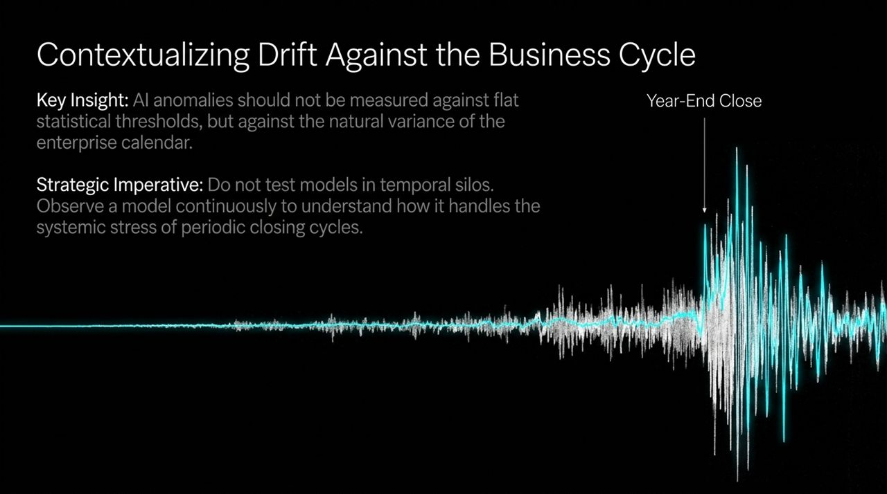
Notes:
A common mistake in AI monitoring is measuring input and data drift against flat, static statistical thresholds.
In enterprise environments, user prompt patterns and transaction volumes naturally fluctuate according to the company's calendar.
For example, during a Year-End Close or quarterly financial reporting period, query volume, vocabulary, and financial transaction stress change dramatically. A statistical anomaly during year-end close might represent normal, high-volume business activity rather than model degradation.
Strategic Imperative: Do not test or observe AI models in temporal isolation. Continuous observability allows you to understand how a model adapts to recurring, real-world business stress.

Slide 8
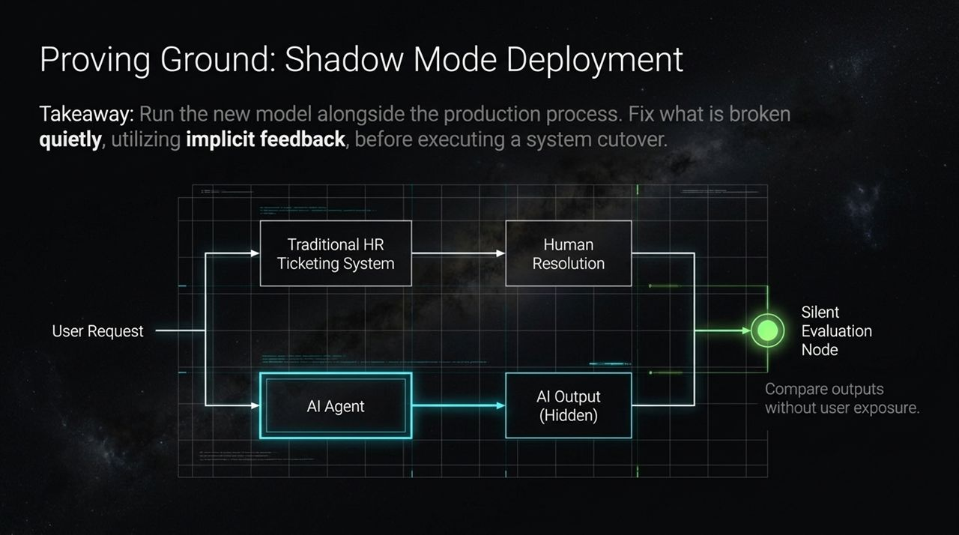
Notes:
How do you safely deploy a new or updated AI agent into a live, high-risk production environment?
The answer is Shadow Mode Deployment.
As shown in this architecture diagram:
A User Request comes into the environment.
The request routes directly through the existing, verified process (e.g., a Traditional HR Ticketing System handled by human resolution).
Simultaneously, a parallel request feeds into the new AI Agent.
The AI Agent's output remains hidden from the end user.
Both outputs flow into a Silent Evaluation Node, which compares the AI's proposal against the human's actual resolution in real time.
Shadow deployments allow engineering teams to identify edge cases, refine prompts, and eliminate silent failures before making a live system cutover.

Slide 9
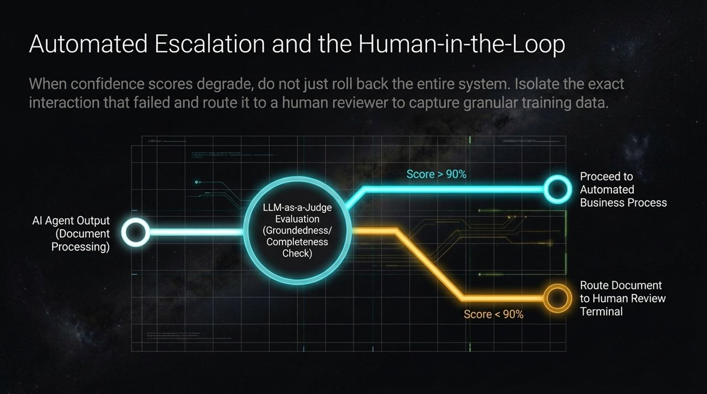
Notes:
When an AI model experiences quality degradation or low confidence, rolling back the entire application is often too disruptive.
A more mature approach is Automated Escalation with Targeted Human-in-the-Loop Routing.
Consider this workflow for document processing:
The AI Agent Output is evaluated in real time using an LLM-as-a-Judge node to measure groundedness and completeness.
If the confidence score is high (e.g., > 90%), the transaction proceeds automatically through downstream business systems.
If the confidence score drops (e.g., < 90%), the specific document is flagged and routed directly to a human reviewer.
This design prevents low-confidence decisions from impacting operations while capturing granular failure data to fine-tune the model.

Slide 10
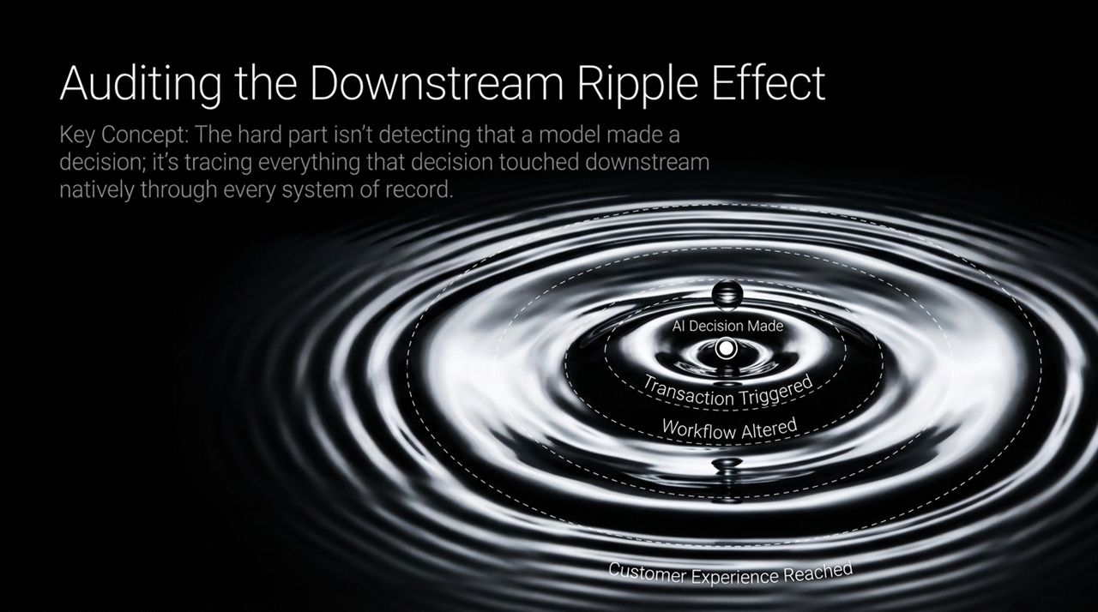
Notes:
Detecting that an AI model generated an output is only the first step. The true governance challenge is auditing everything that decision touched downstream.
As an AI agent takes action, it triggers a chain reaction:
AI Decision Made $→$Transaction Triggered $→$Workflow Altered $→$Customer Experience Reached.
If an AI-driven pricing agent incorrectly grants a billing discount, that decision impacts ERP records, financial ledgers, fulfillment systems, and customer receipts.
To ensure auditability, metadata—including model version, prompt parameters, confidence score, and timestamp—must attach directly to the transaction as it traverses your enterprise systems of record.

Slide 11
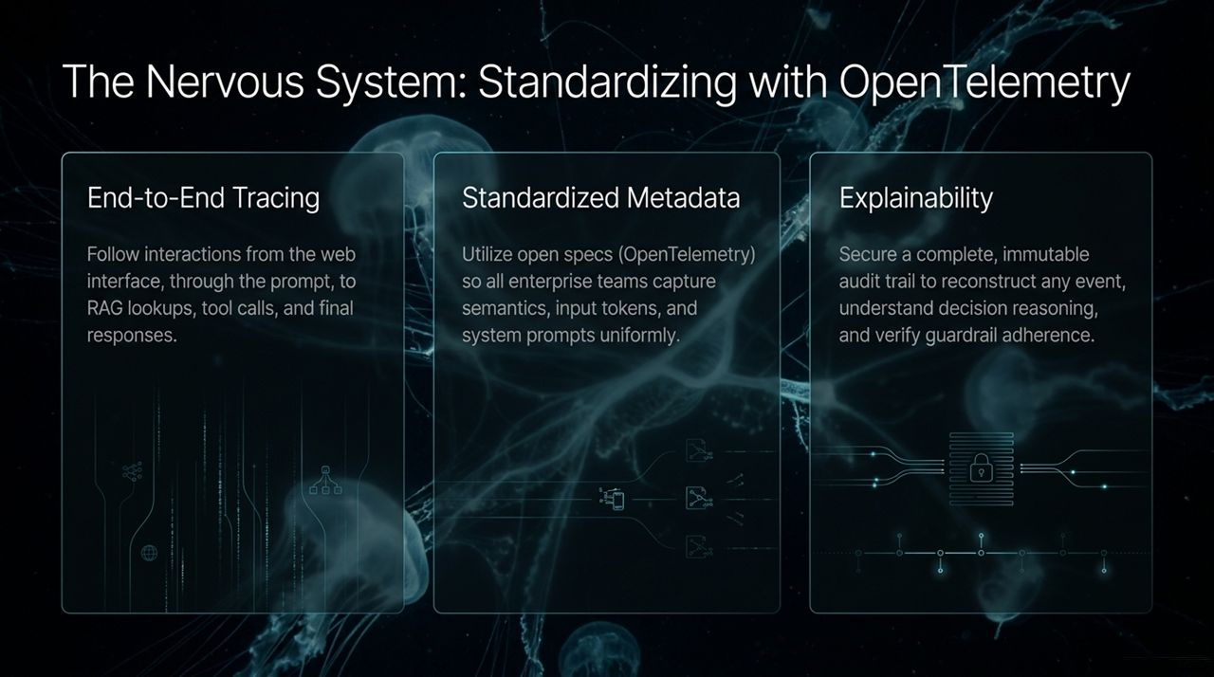
Notes:
To implement end-to-end auditability across disparate technologies, enterprises must avoid proprietary lock-in and adopt open standards.
OpenTelemetry (OTel) has emerged as the industry standard for AI and application telemetry.
OpenTelemetry provides three foundational capabilities for AI observability:
End-to-End Tracing: Trace a single transaction starting from the front-end user interface, through the prompt construction, to vector database (RAG) lookups, tool calls, LLM execution, and final UI rendering.
Standardized Metadata: Enforce consistent semantic conventions across all teams for capturing input/output tokens, model identifiers, and system prompts.
Explainability & Auditability: Secure an immutable audit trail to reconstruct events, analyze decision paths, and verify guardrail compliance during regulatory reviews.

Slide 12
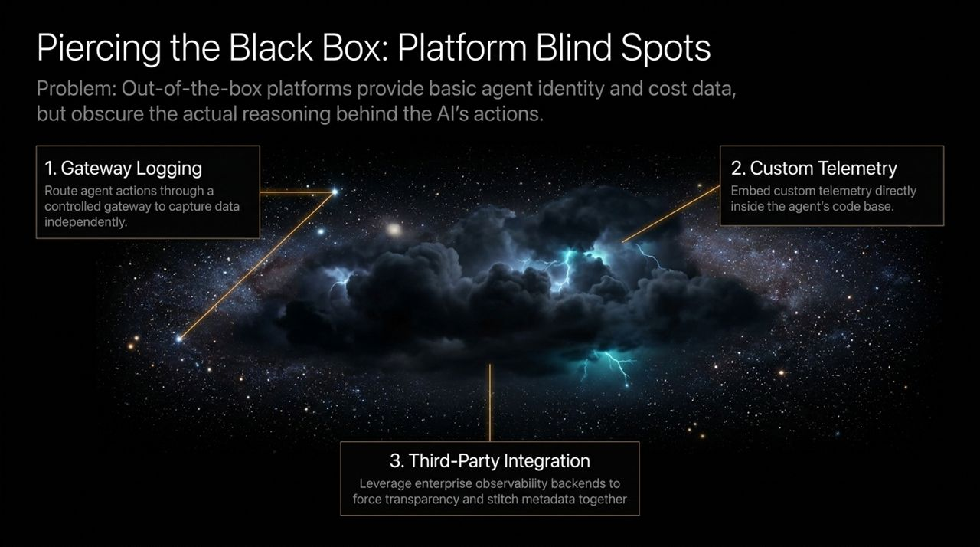
Notes:
A common obstacle when deploying enterprise SaaS or out-of-the-box AI builders (such as Microsoft Copilot Studio) is platform opacity.
Many built-in administrative portals show basic usage metrics and user counts, but hide the internal reasoning, prompt context, and intermediate tool calls.
To gain full visibility, organizations can implement three architectural patterns:
Gateway Logging: Route agent traffic through a controlled API gateway to independently log inputs, responses, and latency outside the SaaS platform.
Custom Telemetry: Embed custom telemetry SDKs directly within bespoke agent code bases to capture internal decision logic.
Third-Party Integration: Stream standardized OpenTelemetry data into enterprise observability backends (such as Dynatrace) to stitch AI telemetry directly to underlying application infrastructure.

Slide 13
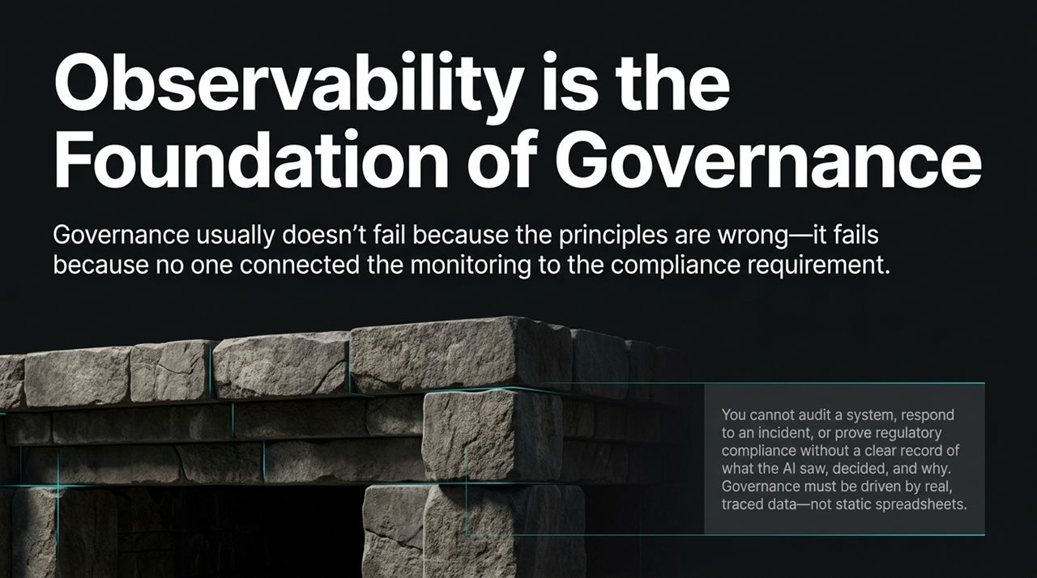
Notes:
There is a frequent disconnect between executive governance policies and technical execution.
Governance frameworks rarely fail because their principles are wrong; they fail because monitoring is not connected to compliance requirements.
You cannot audit an autonomous agent, respond to a security incident, or satisfy regulatory bodies using static policy documents or manual spreadsheets.
Compliance must be backed by live, traced telemetry that proves what the AI evaluated, what decisions it made, and which safety guardrails were executed at every step.

Slide 14
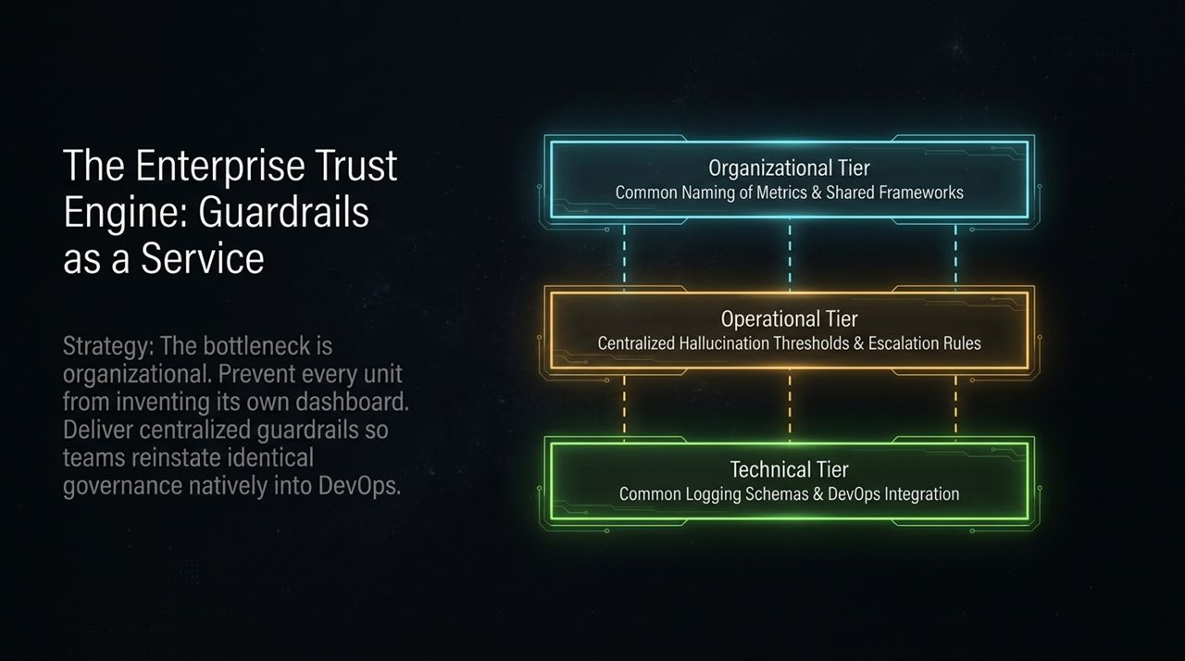
Notes:
As multiple business units build their own AI tools, a major operational challenge arises: fragmentation.
If every team builds custom dashboards, metric definitions, and safety rules, enterprise governance becomes unmanageable.
To slve this, organizations should deploy Guardrails as a Service across three structured tiers:
Organizational Tier: Define shared enterprise metrics, taxonomy, and governance frameworks across all business units.
Operational Tier: Establish centralized hallucination thresholds, safety boundaries, and human escalation workflows.
Technical Tier: Provide standardized logging schemas, OpenTelemetry libraries, and CI/CD pipeline integrations for engineering teams.

Slide 15

Notes:
Looking ahead over the next 12 to 18 months, enterprise AI architecture will shift from single model prompts to complex, multi-agent systems.
In these environments, independent AI agents will coordinate autonomously to execute multi-step business operations.
Observability must evolve beyond tracking individual LLM calls to tracing Agent-to-Agent interactions, tool handoffs, and distributed consensus.
Closing Principle: Trustworthy AI starts with visibility and grows from there. You cannot trust what you cannot see.

Slide 16
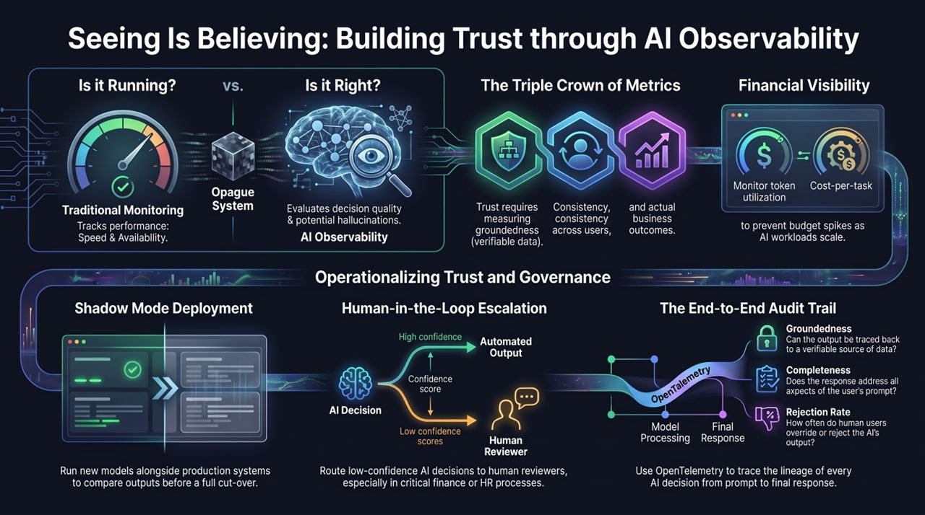
Notes:
To summarize our session, this final playbook slide highlights the four pillars required to operationalize trust across enterprise AI:
1. Shift the Question: Balance traditional APM metrics (Is it running?) with continuous quality evaluations (Is it right?).
2. Measure the Triple Crown of Metrics: Continuously monitor Groundedness (verifiable data sources), Completeness (prompt coverage), and Rejection Rate (human overrides).
3. Implement Safe Deployment Practices: Utilize Shadow Mode Deployments to evaluate new models quietly against production baselines, and configure Human-in-the-Loop Routing when confidence scores drop.
4. Enforce Financial and Technical Audit Trails: Standardize on OpenTelemetry to maintain end-to-end decision lineage from prompt to downstream system impact, while managing token consumption through FinOps allocation.
By grounding your AI strategy in end-to-end observability, your organization can move AI out of sandbox pilots and confidently scale trustworthy systems into production.
Seeing Is Believing: AI Observability & Trustworthy AI with SAP & Dynatrace | Webinar Replay
https://www.youtube.com/watch?v=LglWwQRNhoI

